Slide 1
MAHATMA GANDHI UNIVERSITY
WELCOME TO
ONLINE ATTENDANCE
GUIDELINES/INSTRUCTIONS

Slide 2
WEBLINK
ENTER THE BELOW WEBSITE ADDRESS IN THE WEB BROWSER OF YOUR COMPUTER
http://portal.mguniversity.org.in/

Slide 3
ONLINE ATTENDANCE PROCESS STEPS:
LOGIN:GET USER ID AND PASSWORD THROUG SMS AND LOGIN TO PORTAL
ON EXAM DATES PAGE OF YOUR CENTER: CLICK ON “SELECT” BUTTON ON THAT PARTICULAR EXAM DATE ROW TO GO TO SUBJECT WISE PAGE OF CENTER
D-FORM AND ATTENDANCE: AFTER LOGIN, ON THE FIRST SCREEN(EXAM DATE PAGE OF THE CENTER) DOWNLOAD D FORM AND ATTENDANCE SHEET.
ON SUBJECT WISE PAGE OF YOUR CENTER: CLICK ON “SELECT” BUTTON ON THAT PARTICULAR SUBJECT ROW TO GO TO ATTENDANCE PAGE
ATTENDANCE PAGE:MARK ATTENDANCE, ADD BUFFER IF REQUIRED
ENSURE YOU HAVE MARKED ATTENDANCE FOR ALL CANDIDATES AND PENDING STATUS IS MADE ZERO IN THE FIRST PAGE(AFTER LOGIN PAGE)
PACKING LIST: PRINT THE PACKING LIST

Slide 4
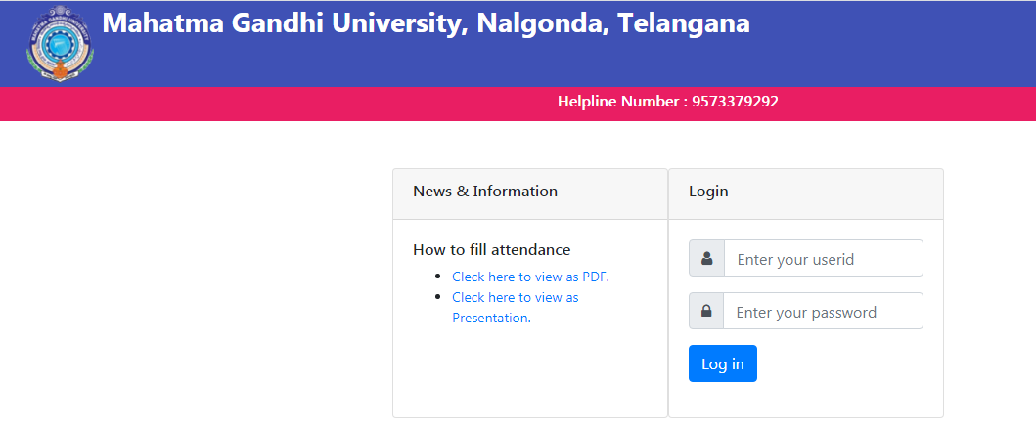
LOGIN PAGE(USERID / PASSWORD PAGE)
SCREEN : 1
ENTER USER ID AND PASSWORD SENT TO YOU THROUGH SMS AND CLICK LOGIN.
HELP LINE NUMBERS ARE GIVEN IN THE ABOVE SCREEN, IN CASE YOU NEED HELP REGARDING ONLINE ATTENDANCE.

Slide 5
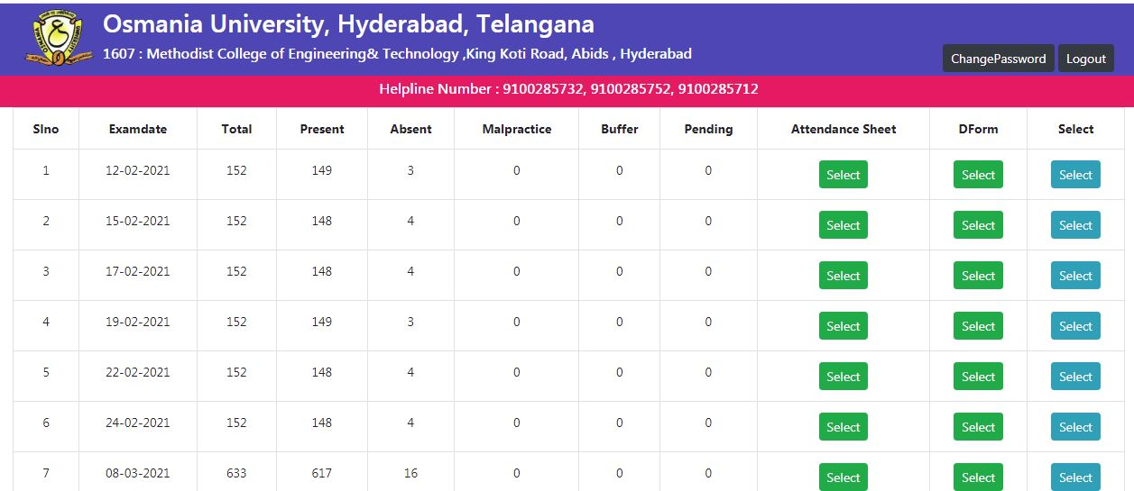
FIRST SCREEN / EXAM DATE PAGE
AFTER ENTERING USER ID AND PASSWORD OF YOUR CENTER FOLLOWING SCREEN WITH YOUR CENTER EXAM DATES WILL BE DISPLAYED.
SCREEN : 2
AFTER CLICKING ON SELECT IN “ATTENDANCE SHEET /DFORM COLUMN” BELOW PAGE WILL BE DISPLAYED.

Slide 6
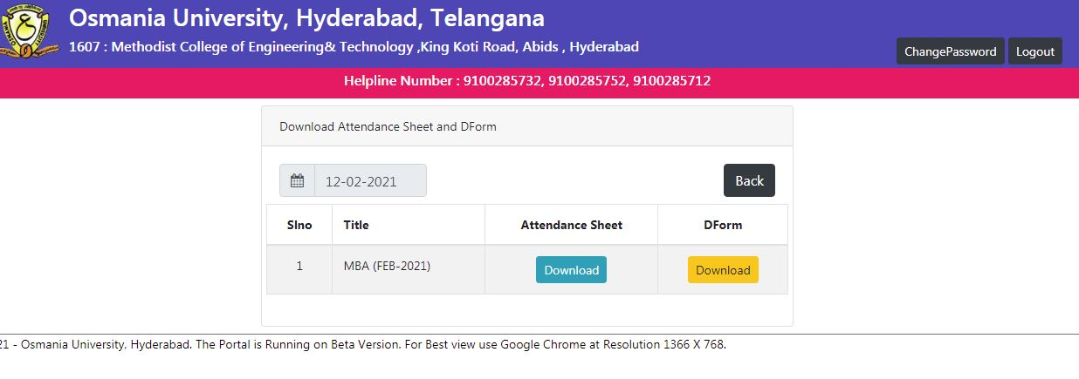
D – FORM / ATTENDANCE SHEET DOWNLOAD PAGE
SCREEN : 3
CLICK ON “DOWNLOAD” BUTTON OF ATTENDANCE SHEET COLUMN TO DOWNLOAD ATTENDANCE SHEET.
CLICK ON “DOWNLOAD” BUTTON OF D-FORM COLUMN TO DOWNLOAD D-FORM PAGE.
TAKE PRINT OUT OF BOTH ATTENDANCE SHEET AND DFORM PAGE.

Slide 7
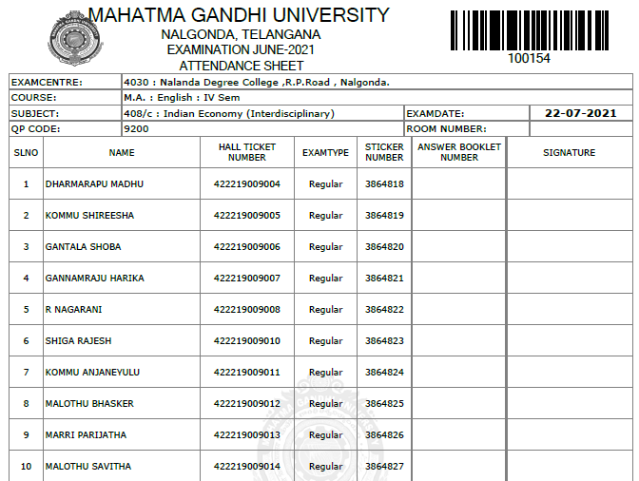
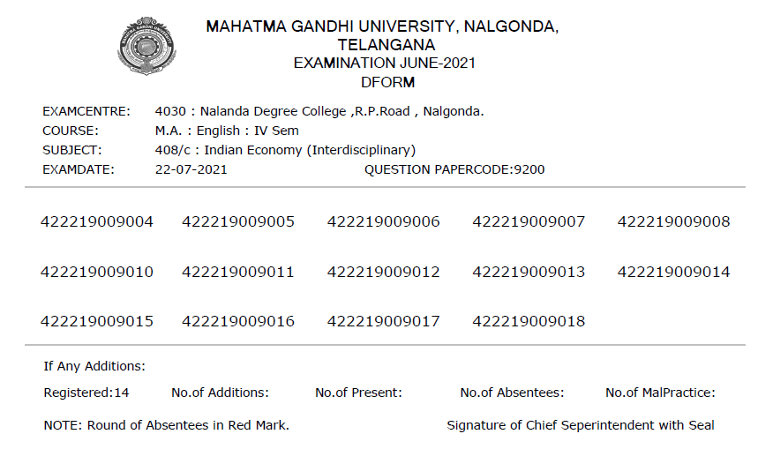
BELOW IMAGE DISPLAYS SAMPLE ATTENDANCE SHEET AND D-FORM.
SAMPLE ATTENDANCE SHEET
D-FORM SAMPLE PAGE

Slide 8
AFTER LOGIN SCREEN,CLICK ON “SELECT” (BESIDE D FORM DOWNLOAD BUTTON)ON PARTICULAR EXAM DATE TO ENTER NEXT STEP OF THE PROCESS.
SCREEN: 2

Slide 9
THE FOLLOWING SCREEN IS DISPLAYED WITH COURSE AND SUBJECTS ON THAT PARTICULAR DATE FOR THE CENTER
SCREEN:3
CLICK ON “SELECT” BUTTON FOR PARTICULAR SUBJECT TO GO TO THE NEXT SCREEN

Slide 10
ATTENDANCE PAGE
AFTER CANDIDATE’S SIGNATURE ON D FORM, FILL THE ATTENDANCE ONLINE IN THE FORMAT SHOWN IN BELOW SCREEN.
SCREEN:4
BY DEFULT ATTENDANCE OF ALL CANDIDATES IS MARKED AS “PRESENT”.

Slide 11
MARKING ATTENDANCE “ABSENT” / “MALPRACTICE”
FOR MARKING A HALLTICKET NUMBER AS ABSENT, PRESS “CTRL+F” OPTION TO ACTIVATE FIND BOX ON TOP OF THE ATTENDANCE PAGE.
ENTER THE “ABSENT” CANDIDATES HALLTICKET NUMBER IN FIND BOX AND PRESS ENTER.
THIS WILL SCROLL DOWN TO THAT PARTICULAR CANDIDATE ATTENDANCE DETAILS. SELECT ABSENT FROM THE DROP DOWN BOX.
SIMILARLY, FOR MARKING MALPRACTICE FOR A PARTICULAR CANDIDATE SELECT “MALPRACTICE” FROM DROP DOWN MENU BY USING CRTL+F “FIND OPTION”.

Slide 12
MARK/EDIT ATTENDANCE-MANAGE ATTENDANCE
SCREEN: 5
IN CASE OF EDITING OF ATTENDANCE OF ANY CANDIDATE CLICK ON “MANAGE ATTENDANCE”

Slide 13
ADDING NEW BUFFER
FOR ADDING BUFFER CANDIDATES, CLICK ON “MANAGE BUFFER” BUTTON ON THE SCREEN AS SHOWN IN IMAGE BELOW.
SCREEN : 6
AFTER CLICKING ON “MANAGE BUFFER” CLICK ON “ADD BUFFER” TO ENTER NEW BUFFER DETAILS.
SEE IMAGE ABOVE TO ADD NEW BUFFER DETAILS

Slide 14
ADDING BUFFER CANDIDATE
SCREEN : 7
SAMPLE BUFFER STICKER. BARCODE NUMBER IS AS SHOWN IN IMAGE 4021854

Slide 15
REPLACING EXISTING STICKER
CLICK ON “REPLACE EXISTING STICKER” IN CASE THE EXISTING STICKER IS DAMAGED, SMUDGED OR TORN.
SCREEN : 8

Slide 16
ATTENDANCE PENDING STATUS
AFTER COMPLETING ATTENDANCE ENTRY ENSURE THE “PENDING STATUS” IN THE DATE WISE PAGE IS MADE ZERO. REFER BELOW IMAGE.
SCREEN: 2

Slide 17
AFTER PENDING STATUS BECOMING ZERO, PROCEED WITH PACKING SLIP AS SHOWN IN IMAGE BELOW
SCREEN : 9
CLICK ON PACKING SLIP BUTTON TO GENERATE THE SLIP. A SAMPLE FORMAT OF PACKING SLIP IMAGE IS DISPLAYED BELOW.

Slide 18
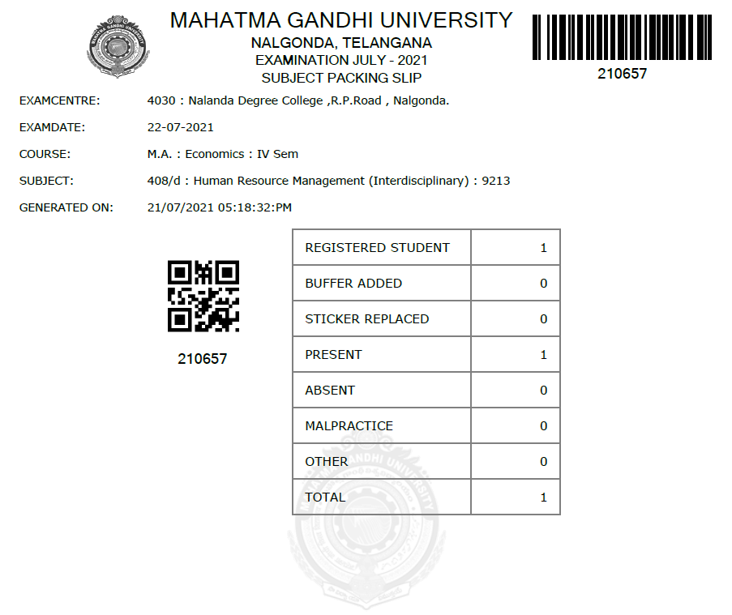
SCREEN : 10
THANK YOU!

